Slide 1
Task Switching Effects in the CVOE Paradigm
Nicholas P. Maxwell

Slide 2
Introduction
Task switching is a popular method for investigating cognitive control
Participants are asked to switch back and forth between two simple tasks
i.e., Classifying letters and doing simple addition

Slide 3
Introduction
Reaction times are slower when participants are forced to alternate between tasks relative to completing only one task
Participants also commit more errors when task-switching

Slide 4
Introduction
Consonant Vowel/Odd Even Task (CVOE)
Participants are shown a letter number combination (e.g., A 25) and are tasked with either classifying letter as C or V or number as O or E
Looking at errors and reaction times (RTs)

Slide 5
Introduction
Pure Blocks
Participants focus on only one of the two tasks
i.e., only doing the odd even task for all trials in a block
Switch Blocks
Participants change task type for different trials in the same block.

Slide 6
Introduction
Alternating Runs Switch Task
Task instructions change after every other trial
i.e., CV, CV, OE, OE, CV, CV

Slide 7
Introduction
Alternating Runs Switch Task
Task instructions change after every other trial
i.e., CV, CV, OE, OE, CV, CV
Every other trial is a switch trial

Slide 8
Introduction
This task allows for comparison of two types of switch costs
Local costs – Difference in RTs or Error Rates for switch and non-switch trials within the same switch block
Global costs – Difference in RTs or Error Rates nonswitch trials (within switch blocks) and pure trials

Slide 9
Introduction
Local switch costs – Comparison of trials within a switch block
Global switch costs – Comparison of non-switch trials (within a switch block) to pure trials (i.e., non-switch blocks)

Slide 10
Introduction
Local switch costs reflect task-set reconfiguration that arises from changing tasks across trials
Global switch costs represent the cost of actively maintaining two different tasks sets relative to only having to perform a single task.

Slide 11
Introduction
Age related differences in performance have been found on the CV/OE task
Previous work by Huff et al. (2015) has shown that global switch costs increased as a function of age.
However, older adults show reduced local switch for RTs relative to younger adults

Slide 12
Introduction
This suggests that older adults are generally are less tuned to the tasks relative to younger adults
i.e., local switch costs will be lower for older adults if they are consistently performing poorly on both switch and non-switch trials

Slide 13
The Present Study
Extend previous CVOE studies on aging by including a random switch Sequence
Task switching occurs with no discernible pattern
e.g., CV, OE, OE, OE, CV, OE

Slide 14
Alternating Runs vs Random Presentation
Switch trials that are presented in a non-predictive sequencing may be cognitively more difficult.
May be more sensitive to cognitive declines.
Error rates and RTs will be greater on the random switch versus alternating runs switch block.

Slide 15
Hypothesis
Older adults should commit more errors and have slower reaction times on the task relative to younger adults
Older adults should also show decreased local switch costs

Slide 16
Participants
85 Younger adults
Sona
62 Older adults
Hattiesburg Clinic
OLLI Subject Pool
36 Healthy
26 MCI

Slide 17
Materials
Stimuli: 432 letter number combinations
e.g., A 15
Letters: Five Consonants (D, J, H, P, S) and Five Vowels (A, E, I, O, U).
Numbers: Randomly selected from 1 to 99.
Pairs were constructed so that half contained even numbers, half odd numbers and half contained consonants and half vowels

Slide 18
Materials
Stimuli were arranged in four blocks
Two pure blocks: 96 CV trials, 96 OE trials
Two switch blocks: 120 Alt run trials, 120 Random switch trials
Each switch block contained 60 switch trials and 60 non-switch trials

Slide 19
Procedure
Participants were informed that they would be completing a decision-making task.
Instructed to respond as quickly as possible without compromising accuracy

Slide 20
Procedure
Pure Trials
Switch Trials
CV
OE
Alt Runs
Random
Notes:
Four versions counter balancing block order. Following the design of Huff et al. 2015, participants always completed the two pure blocks before completing the two switch blocks. Each block began with a ten trial practice

Slide 21
Procedure
MoCA
Demographics

Slide 22
Procedure
For the pure blocks, they were informed that they would be looking at either the number or the letter and would be categorizing it accordingly.
Participants recorded responses with key presses
‘q’ = consonant/odd
‘p’ = vowel/even

Slide 23
q
Consonant
p
Vowel
D 52
D = consonant, q = correct key press

Slide 24
Procedure
Switch blocks included a prompt which told participants whether they would be making decisions about the letter or the number
Same key presses as pure blocks
‘q’ = consonant/odd
‘p’ = vowel/even

Slide 25
q
Consonant
Odd
p
Vowel
Even
Letter
B 55
B = consonant, q = correct key press

Slide 26
q
Consonant
Odd
p
Vowel
Even
Number
D 52
52 = even, p = correct key press

Slide 27
Analysis
Two 3 (Age group) X 5 (Trial type) ANOVAs
Error Rates as DV
RTs as DV
Two 3 (Age group) X 4 (Switch Cost) ANOVAs
Error Rates as DV
RTs as DV

Slide 28
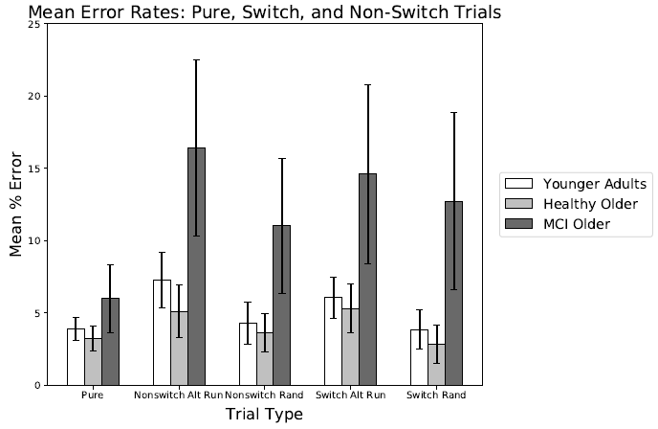
Results – Error Rates
Notes:
Sig effect of trial type (switch trials significantly more errors)
Sig effect of age group (MCI’s committed more errors)
Sig interaction

Slide 29
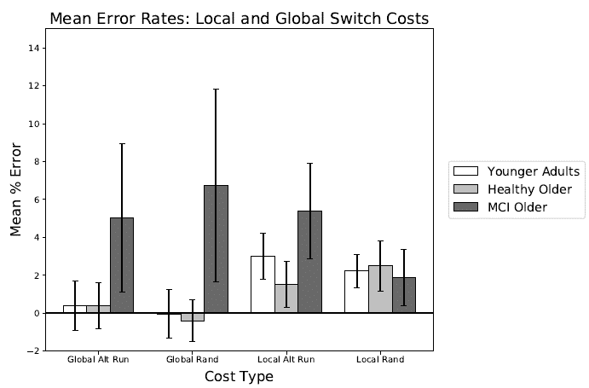
Results – Error Rates
Notes:
Sig main effect of age MCI’s had higher costs across the board
Non-sig type
Sig interaction (local rand did not significantly differ)

Slide 30
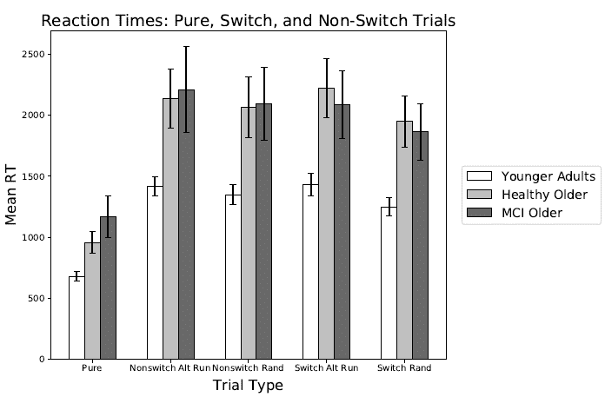
Results – Reaction Times
Notes:
Sig effect of age (older adults sig slower than ya)
Sig effect of type (switch slower than pure)
Sig interaction

Slide 31
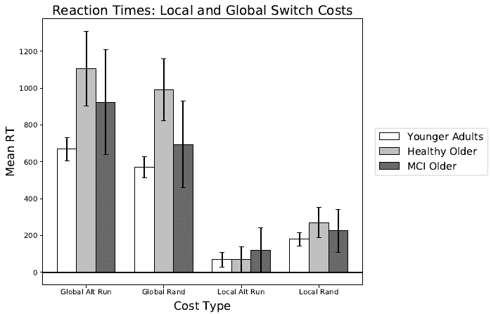
Results – Reaction Times
Notes:
Again, everything is significant
Main effect of age (YAs show lower cost)
Lower local costs
Sig interaction

Slide 32
Conclusions
Older adults produce more errors
Declines in cognitive functioning result in slower reaction times across all trial types
Task-set reconfiguration processes associated with local switch costs are especially taxed for older adults when switching is not predictive.

Slide 33
Limitations
Older adult data
Data collection suspended due to Covid-19

Slide 34
Limitations
Unlike Huff et al. (2015), did not find decreased local switch costs across all errors and RTs
May be due in part to the number of trials (432) and the inclusion of an additional switch block

Slide 35
Questions?

